Slide 1
Perspectives on static/dynamic
Don Syme
Researcher, Microsoft and Community Contributor, @fsharporg
@dsymetweets

Slide 2
Who am I
I’ve worked at Microsoft Research & Microsoft Developer Division for 20+ years
MS now makes tools for nearly all major languages and, as a cloud company, is highly polyglot
MSR has long had a mission to improve the practice of programming, including bringing insights from academia. It’s a wonderful place to observe the industry
About 1/3rd(?) of the world’s professional programmers use tooling from DevDiv, e.g. VS, VS Code, TypeScript, Python tools
Best known as the designer of F#, also C# 2.0 Generics, also F# async

Slide 3
Today
Talk about “static v. dynamic” from the F# perspective
Will particularly focus on F# type providers
Stemmed partly from an online discussion on “type-level” programming more generally

Slide 4
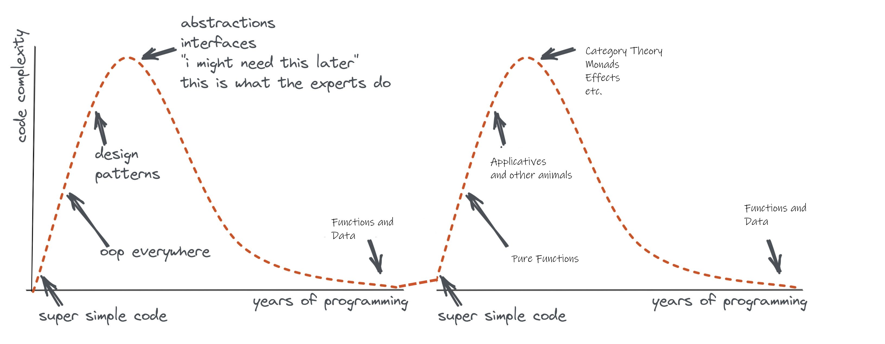
Remember the eternal sweet spot of programming! Functions + Data + Types

Slide 5
2002 - I loved OCaml, by far the best practical language at that time
F# 1.0 was born from an obsession to ensure practical strongly-typed FP was a viable option in the 21st C
(OCaml, Elm and others also help deliver on this)

Slide 6
The F# approach
Start with Core Caml
Stay true to core FP principles
Interoperate
Reuse industrial VM+ecosystem
Deconstruct OO, FP, find synthesis
Include IDE tooling, REPL
Deliver and apply in industry
Long-term home at with .NET/F# Foundations
Focused iterative improvements

Slide 7
Type definitions, modelling, objects
Soundness and
Formalization
Parameterization
Expression-oriented programming
Runtime, ecosystem, interop
Types and Type Inference
Computational
modalities
(comprehensions, async, monads, monoids…)

Slide 8
Nominal objects (classes, interfaces)
Structural objects
Languages must have a formal specification!
Functors (parameterized large components)
Type definitions
Functional objects
Soundness
Soundness is supreme
Functional abstraction and parameterization
Parameterization
Immutable by default, algebraic data
Initialization soundness, no nulls
Expression-oriented programming
Types for modelling, perf, correctness, interop
“F# types are .NET types, .NET types are F# types”
Hindley-Milner for typed succinctness
List comprehensions
Types and Type Inference
Interop
Hindley-Milner modified for objects+more
Monadic notation
Type Providers
Computational
modalities
Fast generic unboxed arith + inline
Rich, compositional computation notation (for comprehensions, queries, async, monads, monoids, applicatives…)
Type-classes and type-level computation
Types for logic and proof

Slide 9
Traditionally ML-family languages have been very “static”
types do not host code
types have no computational content
inferred types must be erasable
no reflection
little or no meta-programming

Slide 10
F# on the static/dynamic axis
Statically typed, tight
Core ML
Nominal object programming
Comprehensions
Modules
“inline” code & statically resolved constraints
Units of measure
Interop with .NET and Javascript
Breaking the rules, loose
Runtime types for objects
Type tests, downcasts
Runtime reflection on nominal types
Runtime reflection on algebraic types
Runtime reflection in generic code
Runtime reflection on expressions (quotations)
Runtime reflection on comprehensions
Compile-time type providers
Compile-time transpilation with FCS
Compile-time analysis with FCS
expr?name

Slide 11
let x = (1,2)
x.GetType()
Runtime type of object
let x = box (1,2)
x :? (int * int)
Runtime type tests
let x = box "hello"
match x with
| :? string as s -> s.Length
| :? int as i -> i+2
| _ -> 3
Runtime type tests
Runtime reflection on nominal types
typeof<X>.Assembly
Runtime reflection on algebraic types
type U = A | B of int
FSharpType.GetUnionCases(typeof<U>)

Slide 12
Runtime reflection in generic code
let f (x: 'T) = typeof<'T>
Runtime reflection on expressions
<@ 1 + 1 @>
Runtime reflection on definitions
[<ReflectedDefinition>]
let f x = x + 1
[<ReflectedDefinition>]
module M = …
Quotations.TryGetReflectedDefinition(…)
Runtime reflection on comprehensions
query { … }

Slide 13
More on F# Type Providers

Slide 14
Proposition 1 Modern programming is intensely information-rich

Slide 15
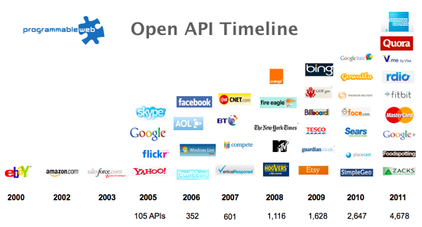
The Information Revolution

Slide 16
Proposition 2 Our languages are information-sparse

Slide 17
Proposition 3 This is a problem (especially for strongly-typed languages)

Slide 18
We need to bring information into the language… At internet-scale, strongly tooled, strongly typed

Slide 19
Paradigm Locator
Statically Typed
Dynamically Typed
making statically typed langs more dynamic
making dynamically typed langs more static
apply moderated static typing much more broadly

Slide 20
Example: FSharp.Data

Slide 21
Authored using reflective programming
Definition:
[<TypeProvider>]
type BasicProvider(config) as this =
inherit TypeProviderForNamespaces(config)
let myType = ProvidedTypeDefinition(asm, "MyNamespace", "MyType", Some typeof<obj>)
let meth = ProvidedMethod("MyMethod", [], typeof<string>, invokeCode=(fun args -> <@@ "Hello World" @@>))
do myType.AddMember(meth)
do this.AddNamespace(ns, [myType])
Use:
open MyNamespace
let s = MyType.MyMethod()

Slide 22
A different kind of meta-programming Lazy, on-demand generation of nominal object type definitions by compiler plugins integrated with type checking Very limited parameters and computation in the language Reflective plugins, not macros nor type-level

Slide 23
Theme #1 Many Data Sources, One Mechanism

Slide 24
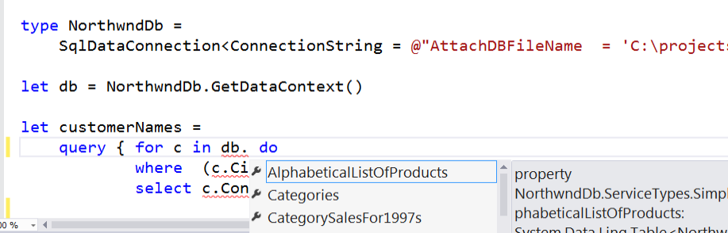
SQL #1

Slide 25
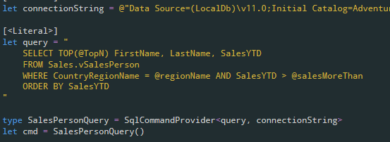
SQL #2

Slide 26
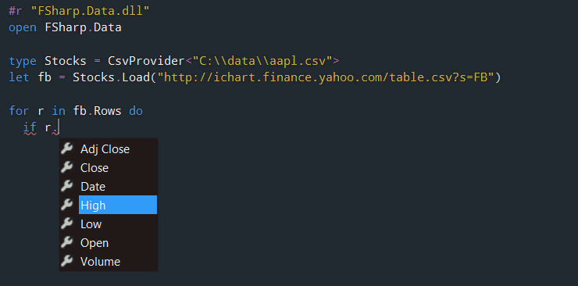
CSV

Slide 27
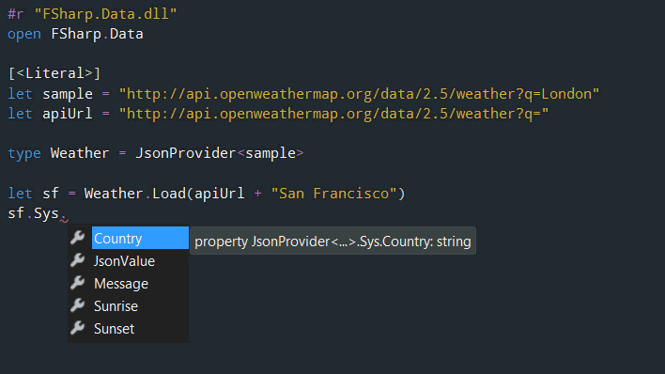
JSON

Slide 28
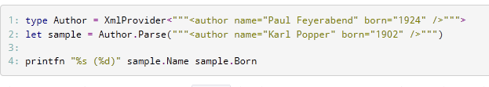
XML

Slide 29
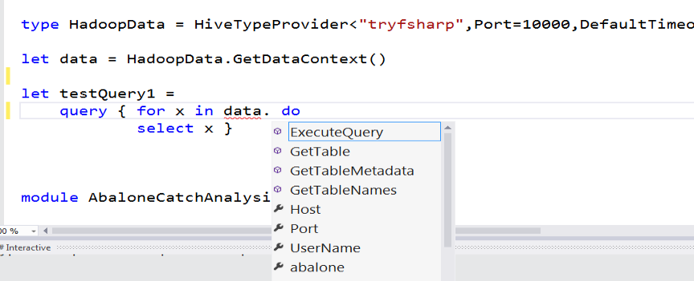
Hadoop/Hive demonstrator

Slide 30
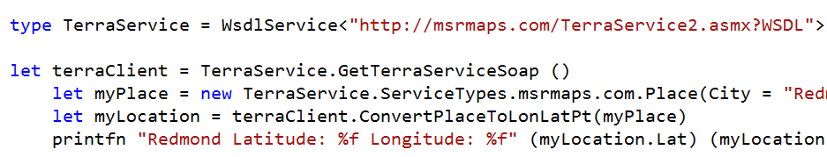
WSDL

Slide 31
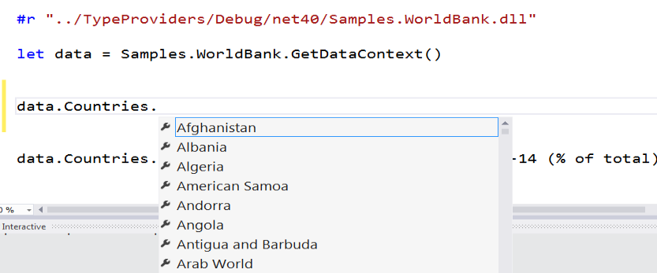
Web APIs

Slide 32
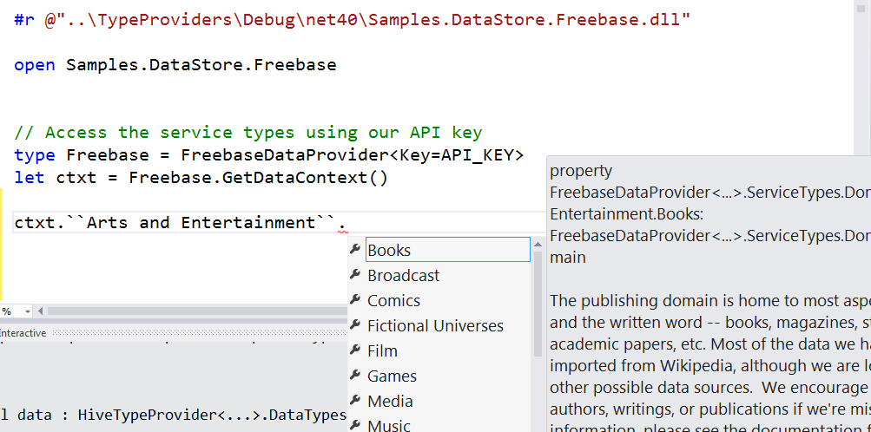
Entity Graphs

Slide 33
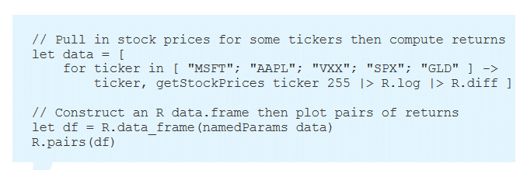
R

Slide 34
Theme #2 Data and Types at Multiple Scales What Type does Data Have Anyway?

Slide 35
Data at Multiple Scales
From Everything to Individuals
Data Scripters need to work with different granularities of schematization
data.AllEntites
data.Automotive.``Automobile Models``
data.Automotive.``Automobile Models``.Individuals.``Porsche 911``
…Only a language that supports scalable metadata interop can operate at all these levels
Every stable entity can get a unique type

Slide 36
Theme #3 Type Systems v. Information Space Metadata Synergy or Conflict? Examples: Types, Schema, Constraints, Units of Measure, Security Information, Documentation, Definition Locations, Help , Provenance, Privacy, Ratings, Rankings, Search…

Slide 37
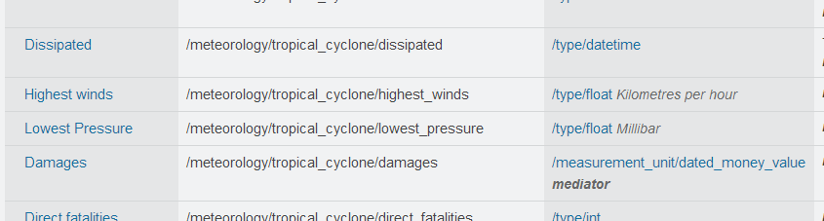
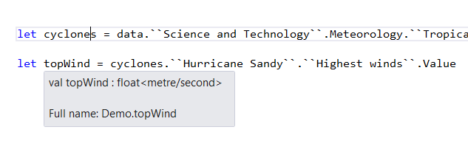
Providing Units of Measure
If the metadata contains units…
via F#’s Units of Measure
…then these can be projected into the programming language.

Slide 38
Theme #4 Schema Change

Slide 39
Hard problem, some progress…
Many data sources are surprisingly stable or in-project
Support “invalidation signals” at coding/design-time
Erasure makes compiled code less fragile
Some data sources support “snapshot dates”
Data scripting has low exposure

Slide 40
Schema change: The temporal life of types?
If type definitions represent abstractions of reality, then they must evolve temporally
Our languages totally fail to capture this
Strong relationship with variational type checking (“checked #if”)
Not in the F# design but really should be

Slide 41
Theme #5 Type Systems Encounter Reality

Slide 42
Type Systems Encounter Reality
We like to see PL systems as logical systems
Traditional logical systems exclude interaction with reality
This is a powerful and simplifying assumption
It is also fundamentally wrong for modern applied programming languages
This goes back to the roots of classical logic
Blame Bertrand Russell and Alonzo Church

Slide 43


Γ $⊢ e$ : τ
Lots of PL work here
Lots of PL work here
The exclusion of reality
The neglected child. Why so static?
Γ₀ = 0

Slide 44
Meditations on Γ₀
Γ₀ is the ever-growing ocean of digital reality around us
Γ₀ is other. It doesn’t speak your language
In theory you are mutually recursive with Γ₀. You are part of it
Γ₀ is being organized at an incredible rate
Γ₀ has many open doors, many locked doors
Some parts of Γ₀ are full of uncertainty and probabilities

Slide 45
Related Work
Ur
Gosu
Scala Type Macros
Scheme/Lisp Macros
Idris
Template Haskell
C# source generators
…

Slide 46
Constraint-based type-level programming?
F# has limited but useful static parametric overloading via member constraints
I recently explained why we limit this sort of thing in F#:
Simple type-classes are never sufficient, slippery slope towards type-level computation
Type-classes add a fragile and contentious classification hierarchy
Any compile-time computation can result in obfuscated, subtle code
Serious implications for compile-time tooling (debugging, profiling, tracing)
Requires end-to-end API redesign
The most empowered person in the team is the category theorist
https://github.com/fsharp/fslang-suggestions/issues/243#issuecomment-916079347

Slide 47
Constraint-based type-level programming?
This is a contentious position ☺
It’s not criticism (I love type-level programming), but observation
A static set of expectations of what is “normal” in this space has developed (via Haskell and category theory). People want their cheese.
There are important uses for constraint-based type-level programming
Verifiability and proof (Idris, Agda)
Ultra high-perf (C++ templates)
Code-interop (Typed Python, TypeScript)
For F# and C#, the presence of reflective, generative type-level programming via addins gives different answers

Slide 48
Conclusions
F# stems from a static-purist tradition
We broke all the rules and added 80-20 mechanisms to strongly moderate this
F# type providers and C# source generators give powerful, practical, reflective type-level programming
Interop looks different when you can automate the type-provision process
Data can have multiple inferred types
Raises all sorts of interesting research/methodology questions
Helps with many things
Interop from static to dynamic/optional-typing (R, Python, TypeScript)
Interop from static to schema (SQL, Swagger)
Interop from static to data (JSON, CSV, XML)
They are an important factor in why we deliberately limit the role of constraint-based type-level programming

Slide 49
Thank you!! Questions?

